Slide 1

Data Science Portfolio
Discussing Crime and wine
Sebastian Firsaev

Slide 2
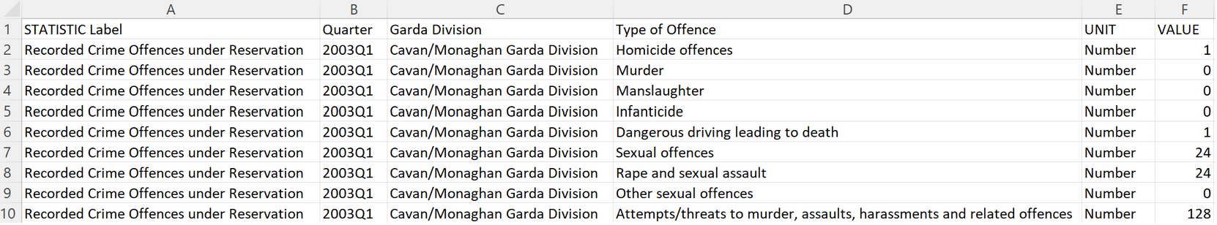
Data Overview
Sourced from cso.ie
Excel file with161,029 rows and five columns
Quarter, Garda Division Type of Offence, UNIT , VALUE

Slide 3
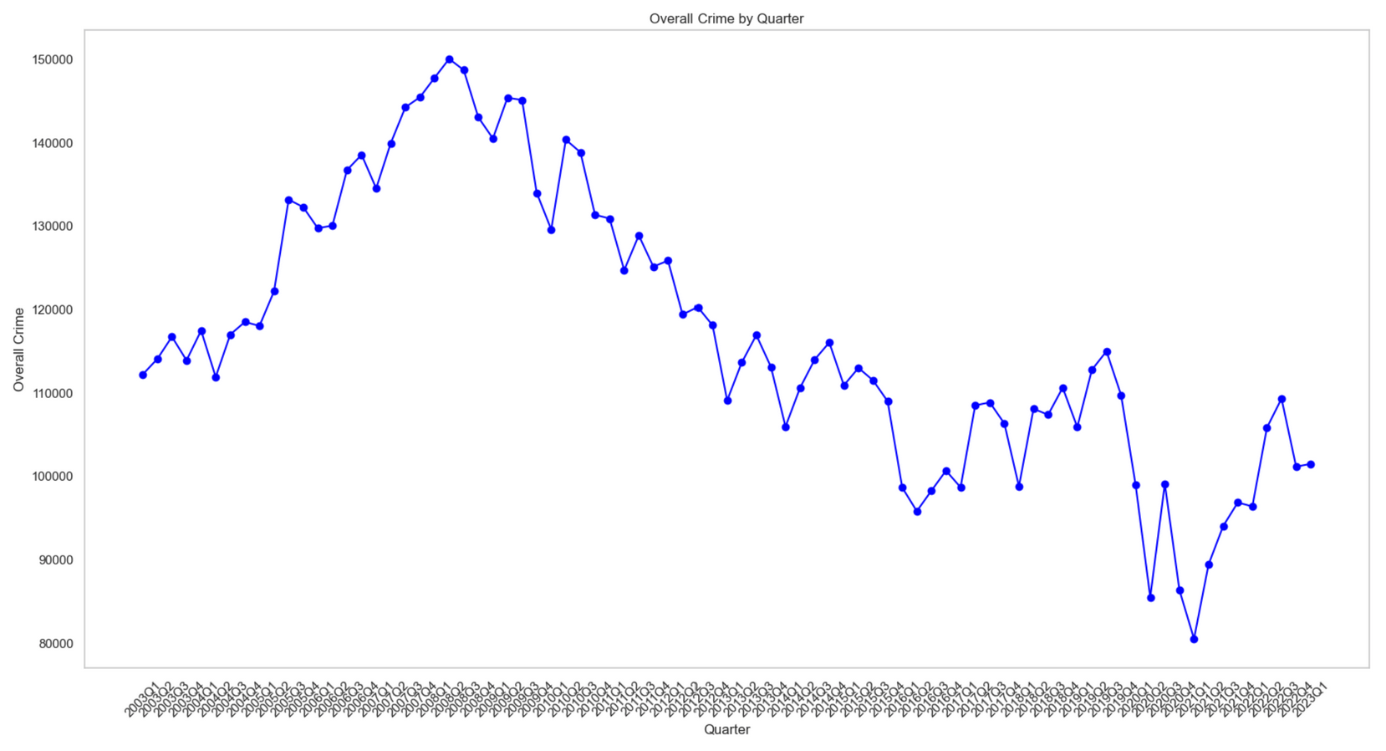
Overall crime trends
Peak in 2008
Sharp decline in 2020
Back to stable rate now

Slide 4
Summary of findings
Year with the most crime: 2008
Year with the least crime: 2021
Most popular type of crime every year: Theft and related offences
Least popular type of crime overall: Infanticide
Garda Division with the most crime: D.M.R. North Central Garda Division
Garda Division with the least crime: Roscommon/Longford Garda Division

Slide 5
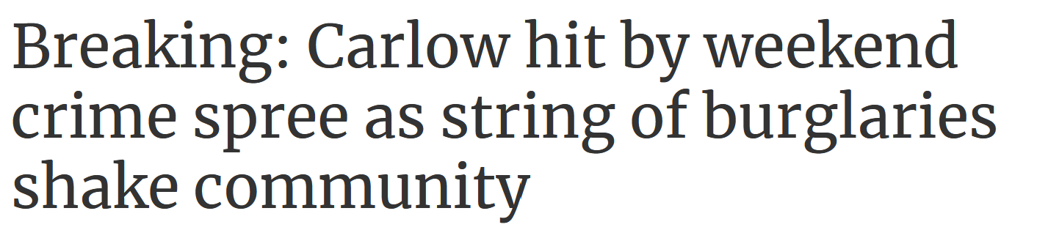
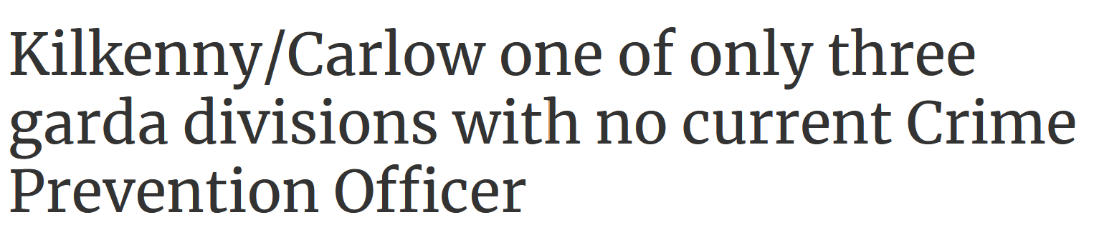
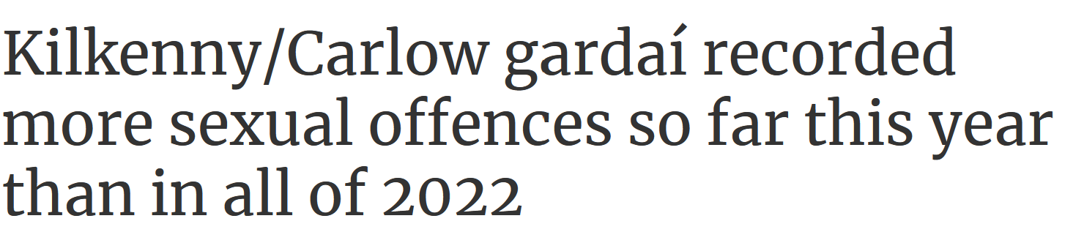
Crime In Carlow – Are Students Responsible?
Impact of outside factors
most numerous crimes were:
theft from shop and drug offenses

Slide 6
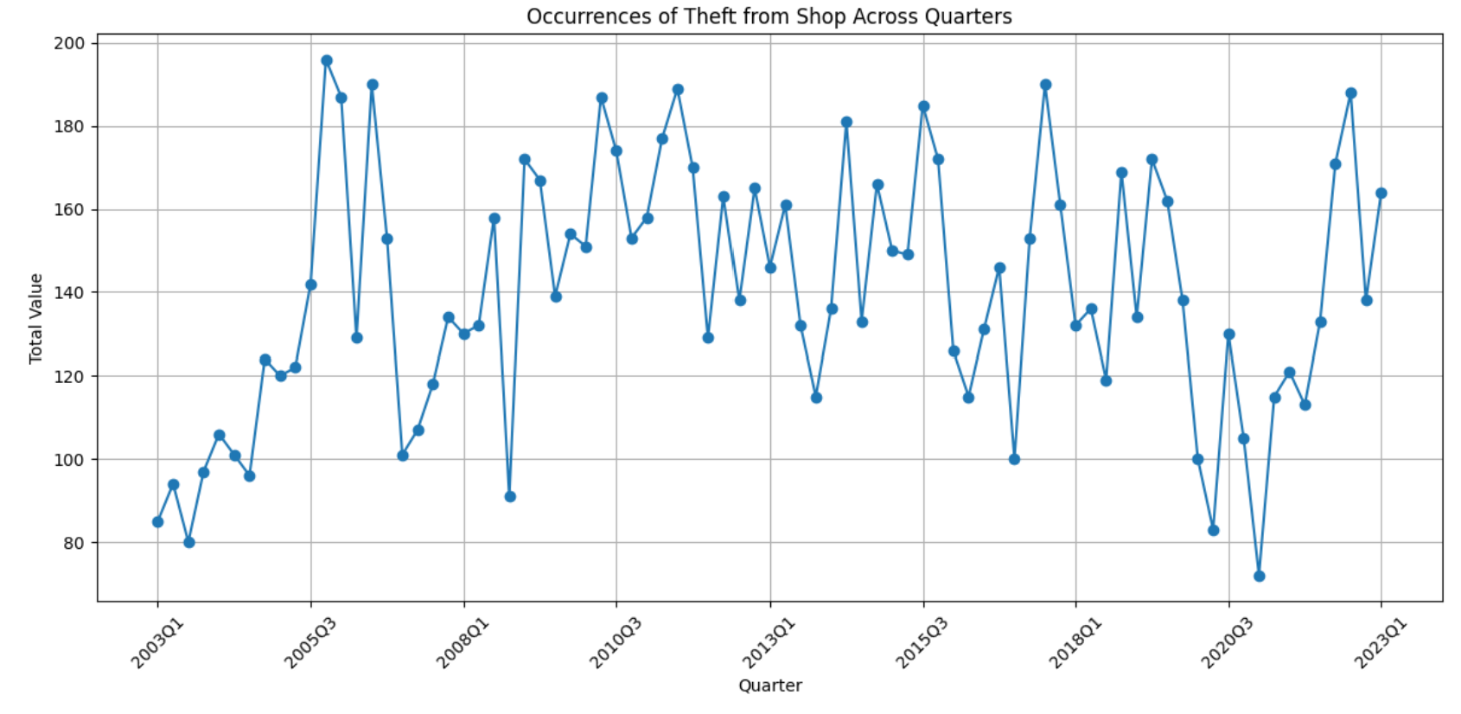
Crime In Carlow – Are Students Responsible?

Slide 7
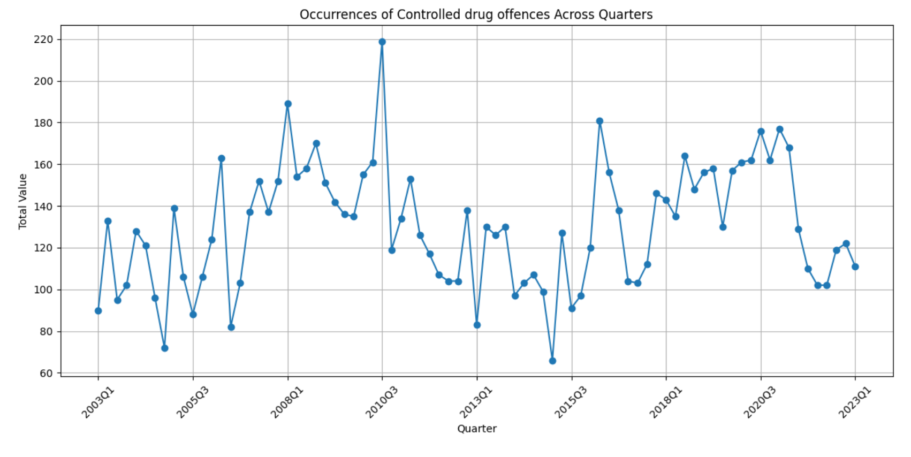
Crime In Carlow – Are Students Responsible?

Slide 8
Crime In Carlow – Are Students Responsible?
For both drug offenses and theft, the crime rate when all the students are back did not significantly increase year by year,
in fact, in theft was lower in quarter 4 in most years (11/20)
However, drug related offenses were higher in quarter 4 (11/20).
I am unable to make a significant conclusion currently.

Slide 9
Random Forests
Errors caused by an outdated code
Example – seaborn-whitegrid was no longer available
Recreated workbook and changed states
Used code from workbook to predict wine quality

Slide 10
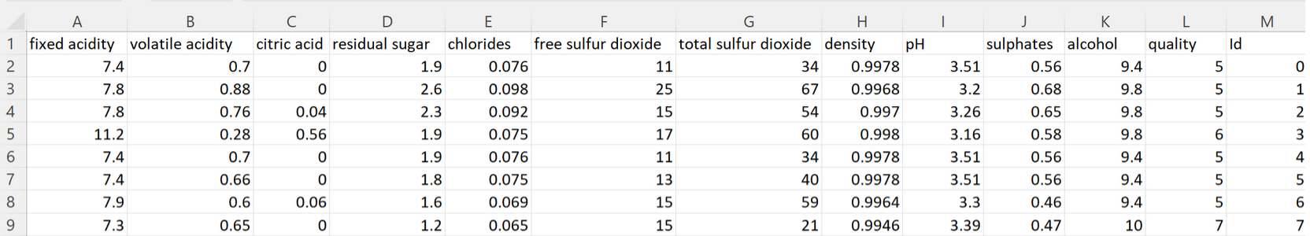
Wine prediction
predictive model to classify the quality of wines based on using a Random Forest Classifier
Data source - kaggle

Slide 11
Wine prediction
utilized a Random Forest Classifier with 100 decision trees to build the predictive
accuracy of the model is 68%
The model performs well in predicting wine quality levels 5 and 6 but struggles with quality levels 4, 7, and 8, as indicated by lower performance metrics and accuracy.
Notes:
Precision emphasizes the model's ability to precisely identify only relevant instances, without labeling too many irrelevant instances as positive.
Recall emphasizes the model's ability to find all the relevant instances within a dataset, capturing as many positives as possible while minimizing false negatives.
A high precision indicates low false positive rate, while a high recall indicates low false negative rate.

Slide 12


Thank You

